Slide 1
3.1 Demystifying the Web
Rob Capra
rcapra@email.unc.edu
June 14, 2016

Slide 2
Part 1:
Why are Web technologies important to data management?

Slide 3
Data and the Web
The data and records we seek to manage are increasingly created, stored, exchanged, archived, and accessed using Web-based technologies
Records considerations (from module 5.1)
Content, structure, context
Reliability, authenticity
Records reflect organizational structures and behaviors
Interpretation and use of digital objects

Slide 4
Importance of Web Technologies
Understanding the Web is important for…
preservation decisions
characterizing and preserving digital data
making data available
search, surrogates, affordances, permissions
representations of information
Preserving context and meaning
Layers of abstraction, data transmission, and meaning
Representation and interpretation
(see also module 5.1)

Slide 5
Importance of Web Technologies
Understanding how data is transmitted is important to preservation, archival, data management, and future access.
Understanding what meta-data is captured and transmitted (and what is not) is important to preserve context.
Understanding data sources, data exchange formats is important for data management.
Understanding Web protocols helps understand limitations, meta-data, and context.

Slide 6
Web technologies influence many aspects
Organization
Metadata
Ethics
Representation
Preservation
Information
Science
Knowledge
Domain
Summarization
Inference
Modeling
Evaluation
Context
Content
Culture
Application
Data
Science
Statistics
Computer
Science
Algorithms
Efficiency
Machine architectures
Automated processes
(from module 1.1)

Slide 7
Challenge: Managing Blurred Boundaries
Applications, Interfaces, Security
Open WWW
Private Web
Curated Web
(from module 1.1)

Slide 8
Topics
How does the Web work?
Web protocols and data flows
Components of a LAMP stack
Managing client-server interactions
Session persistence and cookies
Security issues
Javascript, AJAX, and asynchronous data exchange
Common web formats (JSON, XML, RDF)
REST APIs; Feeds

Slide 9
Part 2:
How does the web work?
What happens when you click a link?
… submit a form?

Slide 10
Client browser requests static HTML page
DNS Server
Server Storage
(1) Request IP address of foo.com
(2) Returns IP address (e.g. 192.168.1.1)
bar.html
Client Web Browser (e.g., Firefox)
Web Server
(e.g., Linux)
(4) Apache receives HTTP GET request, looks for bar.html on disk.
(3) HTTP GET bar.html / HTTP 1.1
Apache
(5) Apache sends contents of bar.html as HTTP response to client
(6) Client Web browser displays bar.html as a web page

Slide 11
Components (part 1)
Client Web browser
Allows user to request HTML web pages
Displays pages
Ex: Firefox, Chrome, Safari
DNS server
Client sends DNS server a host name (e.g., nytimes.com)
DNS server returns the IP address (e.g., 170.149.159.130)
Web server
Computer whose main function is to serve web pages
Runs software to listen & respond to HTTP requests
Ex: Apache, Microsoft Internet Information Services (IIS)
Apache
Widely deployed open-source web server software
Handles HTTP requests
Server storage
HTML files (web pages) are stored

Slide 12
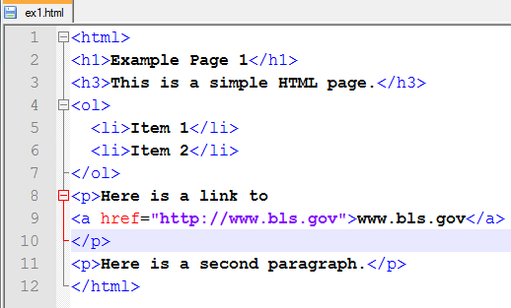
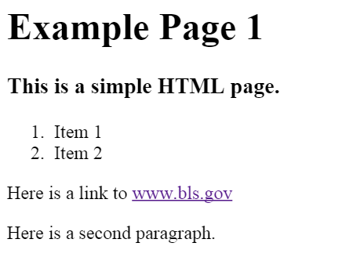
HTML
HTML is a standard for representing hyperlinked data, structures, and concepts
Specific Web browsers display this data in more or less the same visual way, but other presentations are possible

Slide 13
Static vs. Dynamic Web Pages
Static web pages
Content is pre-coded and does not change
The exact same HTML is sent each time the page is requested.
Static web pages are created (typically in HTML) and stored on the server as files.
Dynamic web pages
Content is dynamically created from a script that runs on the server
Each time the page is requested the script is run and the HTML for the page is generated from the script
Server scripts are written in programming languages such as PHP, ASP .Net, Ruby on Rails, and Python.
Implications for archiving?

Slide 14
Client requests a dynamic page (e.g. PHP)
DNS Server
Server Storage
(1) Request IP address of foo.com
(2) Returns IP address (e.g. 192.168.1.1)
bar.php
Client Web Browser (e.g., Firefox)
Web Server
(e.g., Linux)
(4) Apache receives HTTP GET request, looks for bar.php on disk.
(5) Apache runs bar.php using PHP.
(6) In this scenario, the bar.php code produces HTML output.
(3) HTTP GET bar.php / HTTP 1.1
Apache
PHP
(7) Apache sends the HTML output produced by running bar.php as an HTTP response to client.
(8) Client Web browser displays the content returned as a web page

Slide 15
Dynamic Web pages
Server scripts may access data stored in a database or other data sources (including other Web resources)

Slide 16
Client requests a dynamic page w/DB
DNS Server
Server Storage
(1) Request IP address of foo.com
(2) Returns IP address (e.g. 192.168.1.1)
bar.php
Client Web Browser (e.g., Firefox)
Web Server
(e.g., Linux)
(4) Apache receives HTTP GET request, looks for bar.php on disk.
(5) Apache runs bar.php using PHP.
(6) In this scenario, the PHP code issues a query to the database to get data.
(3) HTTP GET bar.php / HTTP 1.1
Apache
PHP
(8) Apache sends output produced by running bar.php as an HTTP response to client.
(9) Client Web browser displays the content returned
Database Server
(e.g., MySQL)
(7) The database executes the query and returns the results to PHP.

Slide 17
Components (part 2)
PHP
PHP is a server-side programming language
Commonly used for web development
Integrates well with Apache web server software
Database
MySQL/MariaDB is open-source relational database software
Currently (2015) MySQL and MariaDB are “drop-in” compatible
Commonly used for web development
PHP has methods for issuing queries and receiving results from MySQL/MariaDB

Slide 18
LAMP Stack
Linux
Operating system for Web server
Apache
Web server software that handles HTTP requests
MySQL/MariaDB
Relational database
PHP
Server-side scripting language for Web development

Slide 19
Archiving Issues
Each of the components in a LAMP stack are part of the context for presenting the Web pages that are stored on the server
What is needed to preserve web pages (or full web sites) as they were originally created and presented (e.g. consider a site from back in 1995)?
Software versions of all LAMP components
Data sources for any dynamic pages
Client browser versions
Plug-ins or other technologies used
...

Slide 20
Focus: Domain Name Service (DNS)
DNS Server
Server Storage
(1) Request IP address of foo.com
(2) Returns IP address (e.g. 192.168.1.1)
bar.html
Client Web Browser (e.g., Firefox)
Web Server
(e.g., Linux)
Apache

Slide 21
IP Addresses and DNS
Computers on the web are identified by IP addresses
e.g., 192.168.1.1
Domain Name System
Hierarchical naming system
.com, .gov., .edu
.ca, .au, .tv
DNS Registrars
Maintain mappings of names to IP addresses
Distribute this list to DNS servers
DNS Servers
Given a name, returns an IP address
Issues:
Who do you trust?
(Google DNS 8.8.8.8)

Slide 22
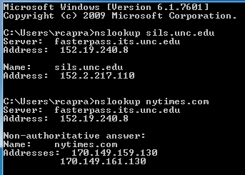
nslookup
Start menu → search box (bottom of menu)
Type in (then press enter): cmd
At the prompt, try:
nslookup sils.unc.edu
nslookup nytimes.com
DNS served used
IP address returned

Slide 23

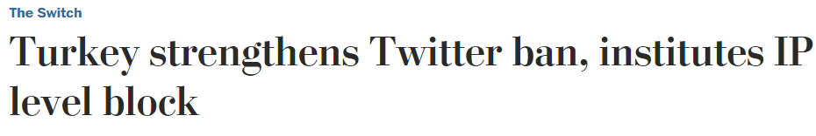

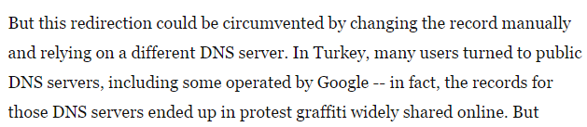
Importance of DNS
https://www.washingtonpost.com/news/the-switch/wp/2014/03/22/turkey-strengthens-twitter-ban-institutes-ip-level-block/

Slide 24
Focus: HTTP
DNS Server
Server Storage
bar.php
Client Web Browser (e.g., Firefox)
Web Server
(e.g., Linux)
(3) HTTP GET bar.php / HTTP 1.1
Apache
PHP
(7) Apache sends the HTML output produced by running bar.php as an HTTP response to client.

Slide 25
OSI Layers
Layer | Example(s)
7. Application | HTTP, FTP
6. Presentation | HTML, CSS
5. Session | SSL
4. Transport | TCP, UDP
3. Network | IPv4, IPv6
2. Data link | PPP
Physical | Ethernet, DSL, USB

Slide 26
HTTP Protocol
HyperText Transfer Protocol
Client-server communication
Request/response
HTTP usually uses TCP/IP
Default is port 80
“Connectionless” and “stateless”
After request/response, connection dropped
No state kept between requests
(some exceptions for HTTP 1.1)

Slide 27
Universal Resource Identifiers (URIs)
Protocol://Server/Path/Object
http://www.ils.unc.edu/~rcapra/teaching.html
Protocol – these include: http, ftp, mailto, news, file
Server –
the client will use DNS to lookup the IP address for this hostname
Path – specifies where on the web server storage the item is located
Object – specifies the specific object being requested (e.g., name of the html file)

Slide 28
HTTP Request & Response
HTTP uses a request-response paradigm
Client (your web browser) sends an HTTP request to a web server
A typical request might ask for a page, image, PDF file, structured data (XML), etc.
The web server receives the request
If it has the requested resource and the permissions are correct, then it will return it in a HTTP response
If the server cannot satisfy the request, it will typically return an error code (e.g. 404 not found)

Slide 29
Example HTTP Request
HTTP requests are sent by the client (web browser) to the web server using structured, plain-text instructions that are part of the HTTP protocol
Think of this like a conversation with a very limited set of things that each side can say.
GET /inls760_001/lect1/foo.html HTTP/1.1
Accept: text/plain, text/html
Host: www.ils.unc.edu
Request header

Slide 30
HTTP Response
HTTP/1.1 200 OK
Date: Tue, 15 Jan 2008 18:47:49 GMT
Server: Apache/2.0.52 (Red Hat)
Last-Modified: Tue, 15 Jan 2008 18:46:48 GMT
Content-Length: 118
Content-Type: text/html; charset=ISO-8859-1
<html>
<head>
<title>Test</title>
</head>
<body>
<h1>Test</h1>
Here is some text.
</body>
</html>
Response headers
(metadata)
Response body
(content)

Slide 31
HTTP Requests
GET
Used to retrieve a document
HEAD
Returns headers, but no content/body
POST
Can upload data to the server
e.g. forms

Slide 32

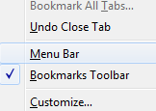
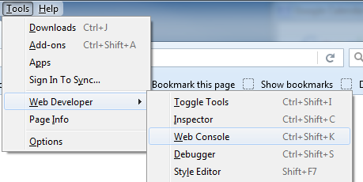


Ex: HTTP Requests & Response
Firefox → right-click to right of tabs
Check “menu bar”
Now go to menu bar → Tools → Web Developer → Web Console
Click “Network”
Try going to a BLS URL: http://www.bls.gov/ncs/ocs/sp/nctb1476.txt

Slide 33
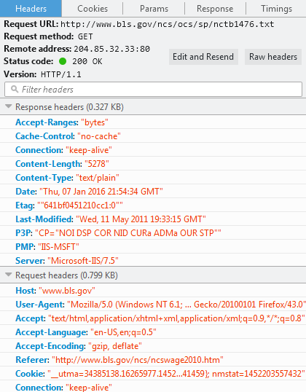
Ex: HTTP Requests & Response
You should see in the console:
Click the row for details:

Slide 34
Ex: HTTP Requests & Response

Slide 35
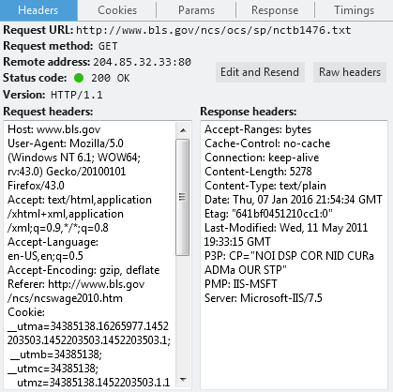
Ex: HTTP Requests & Response
“Raw headers”

Slide 36
Focus: Web Server
DNS Server
Server Storage
bar.html
Client Web Browser (e.g., Firefox)
Web Server
(e.g., Linux)
(4) Apache receives HTTP GET request, looks for bar.html on disk.
Apache
(5) Apache sends contents of bar.html as HTTP response to client

Slide 37
Web Server
“Web server” is hardware, but also software
Apache and IIS are widely used server software
Listens for HTTP requests (on TCP/IP port 80)
Receives and processes HTTP requests
Looks for resources that are requested
Responds to request with an HTTP response
Can generate status codes:
202 – OK
403 – Forbidden
404 – Not found

Slide 38
HTML
HTML
Language used to create Web pages
HTML is text
Title, links, images, headings, lists
View HTML in browser:
Firefox → load a page (e.g., bls.gov)
Right-click → View Page Source
Authoritative resource – W3C specifications
HTML 4.01
http://www.w3.org/TR/html4/

Slide 39
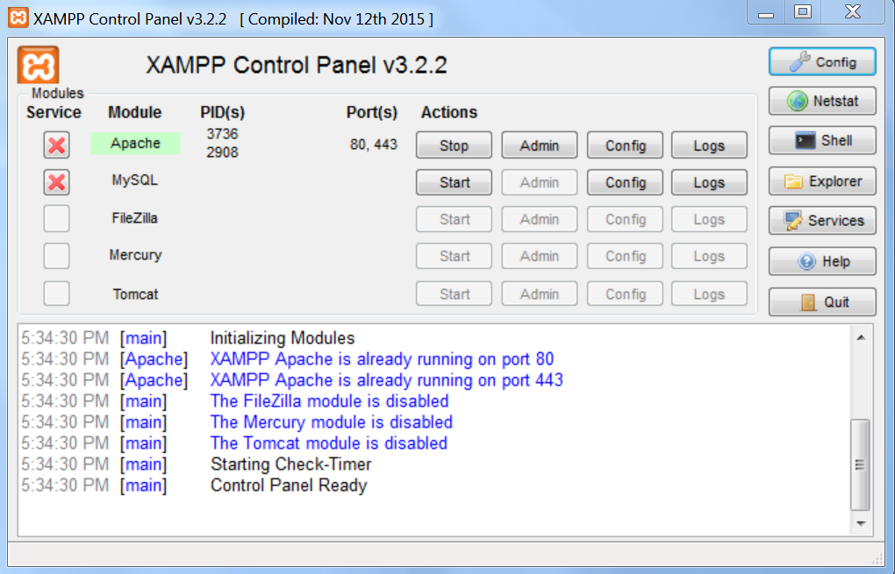
LAMP in Action
XAMPP – cross-platform Apache, MySQL, PHP package
Start menu → All Programs → XAMPP → XAMPP Control Panel

Slide 40
Warning About Running Services
XAMPP runs Apache and MySQL servers on a local machine
Be aware – there are security issues related to running these types of servers/services and these tools should only be installed/configured by qualified IT administrators.

Slide 41
Warning About Code Examples
Code examples in these slides have been designed only to introduce the main concepts.
Most of the examples do NOT include security measures that would be needed in a deployment environment, and they are NOT intended to represent code that would be safe to deploy.

Slide 42
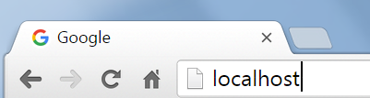
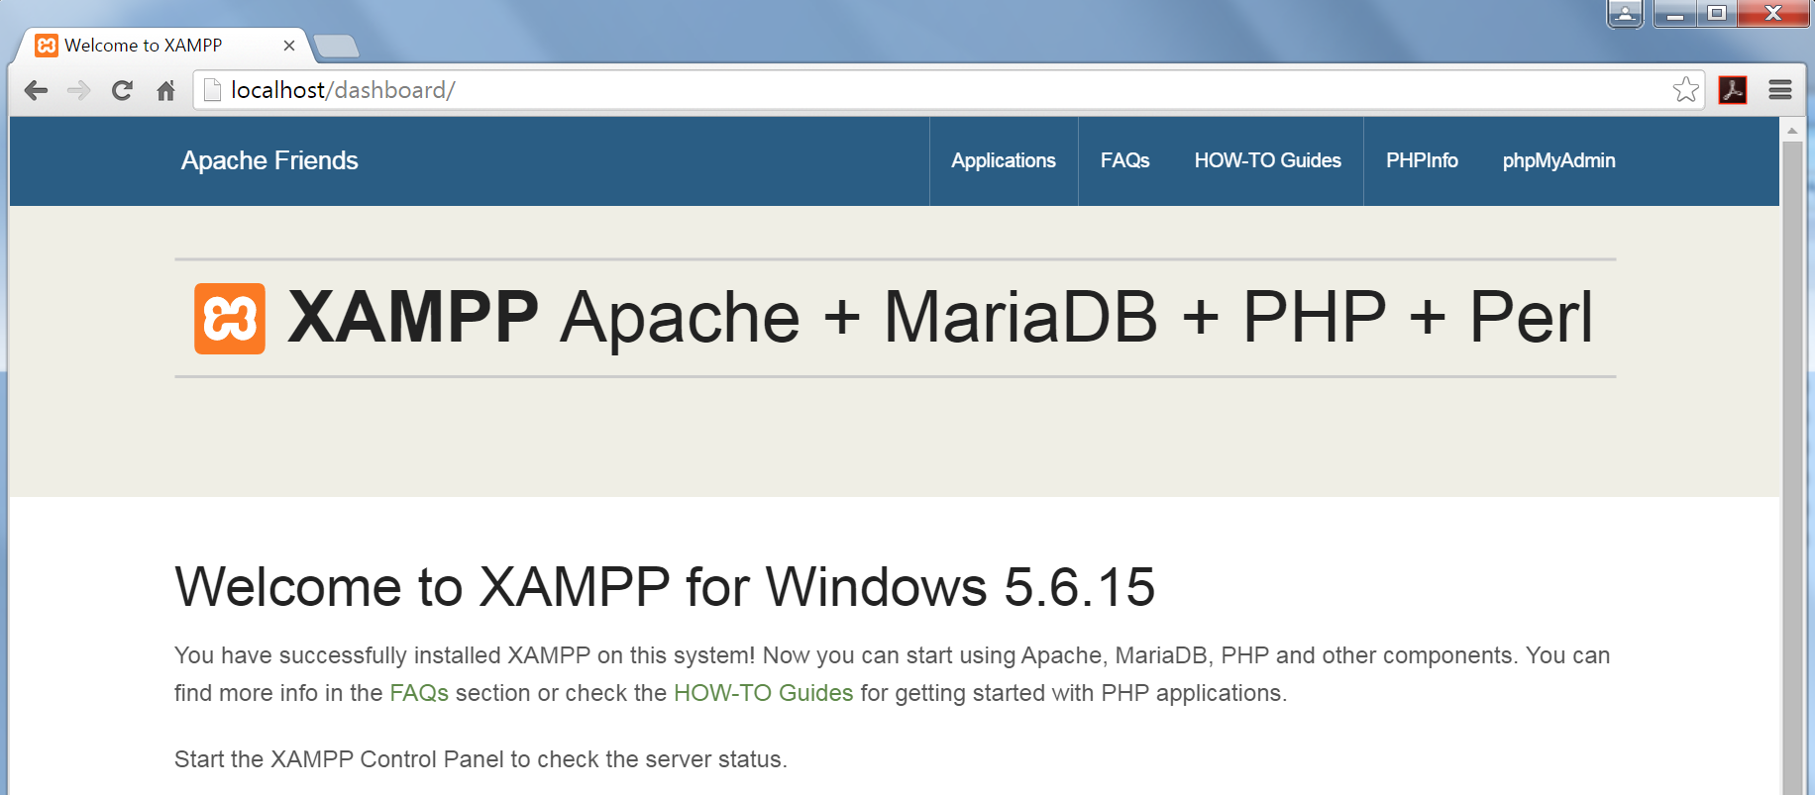
LAMP in Action
Firefox → type in URL: localhost

Slide 43
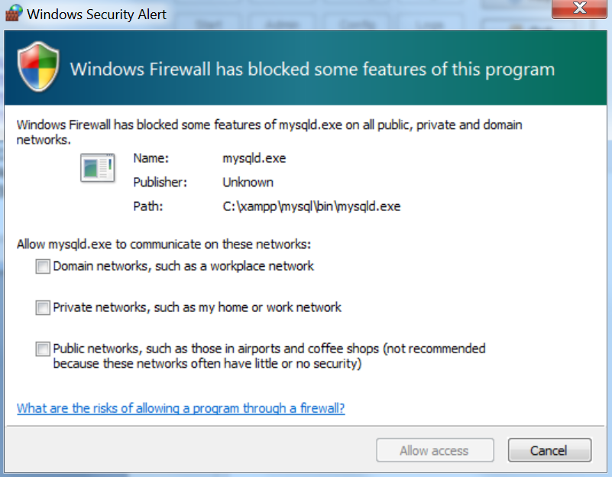
LAMP in Action
Next we will turn on MySQL
This may generate a Windows Security Alert
For these exercises, do NOT allow MySQL to communicate on any networks.
Unselect any checkboxes and click Cancel

Slide 44
LAMP in Action
To start the MySQL server, go to the XAMPP Control Panel
Click Start button for MySQL

Slide 45
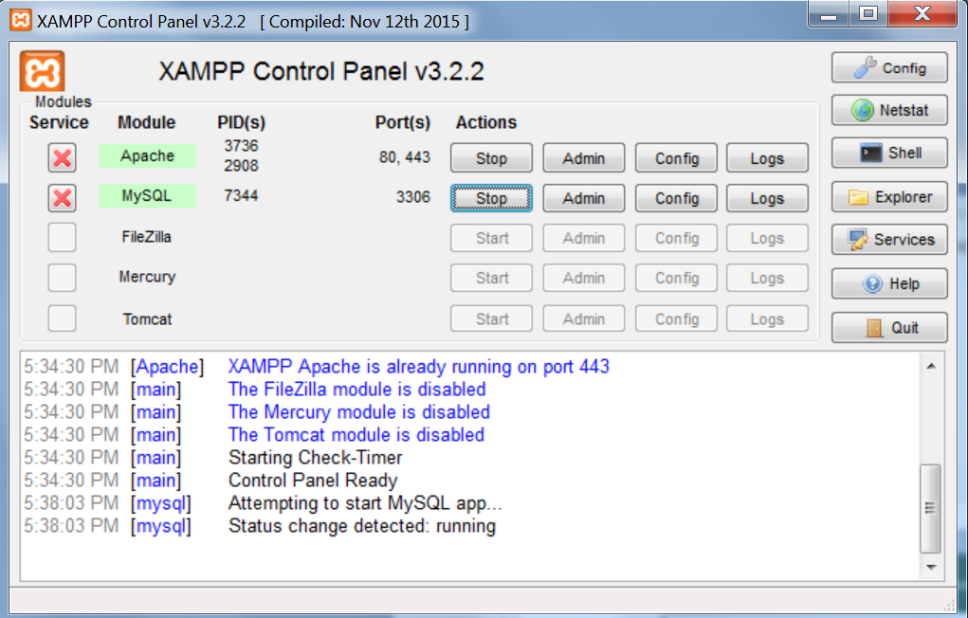
LAMP in Action
If it worked, you should see something like this:

Slide 46
LAMP in Action
Back to Firefox → go to URL: localhost → click phpMyAdmin

Slide 47
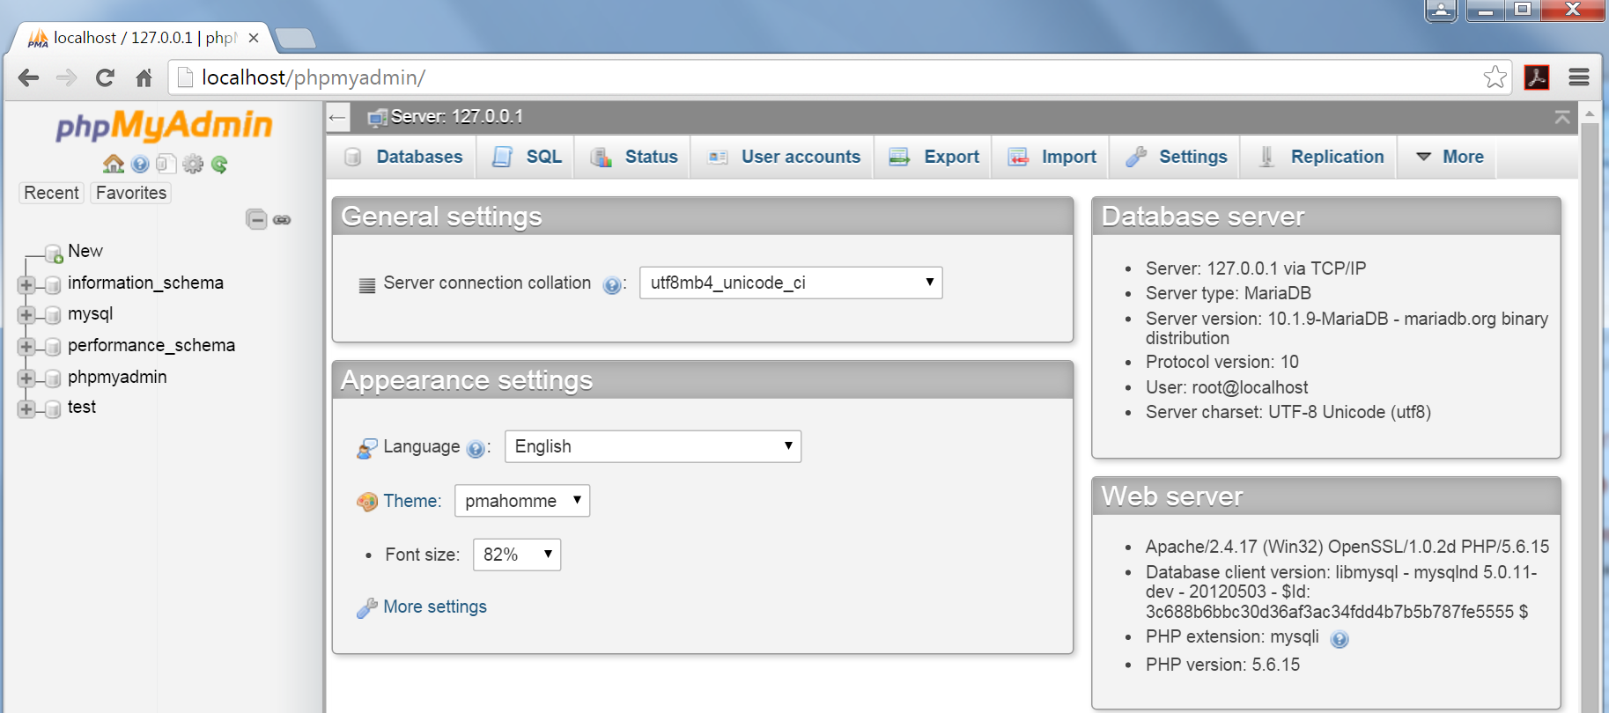
LAMP in Action
If it worked, you should see something like this:
If so, you are now running Apache, MySQL, and PHP locally on the computer.

Slide 48
Load Example Files
Locate the file: osc_webdb_examples.zip
Right-click the file and select “Extract All…”
When prompted, click “Extract”
This should open a new window with a single folder titled “webdb”.
Open a new window and navigate to this directory: C:\xampp\htdocs
Drag the “webdb” folder into the C:\xampp\htdocs directory. This should copy the whole folder.

Slide 49
Try out HTML
Open this file in Notepad++ : C:\xampp\htdocs\webdb\ex1.html

Slide 50
Try out HTML
In Firefox, open this URL: localhost/webdb/ex1.html

Slide 51
Try out HTML
Try:
Change a heading.
Add an item 3.
Add a third paragraph.

Slide 52
Server-Side Scripting
Server-side scripting
Scripts are programs that run on the server
Scripts can return data to the client web browser
Returned data can be
Text, HTML, XML, JSON, Javascript or other data
Apache
Open-source
PHP is well-supported
Microsoft
Internet Information Services (IIS)
ASP and .NET are well-supported

Slide 53
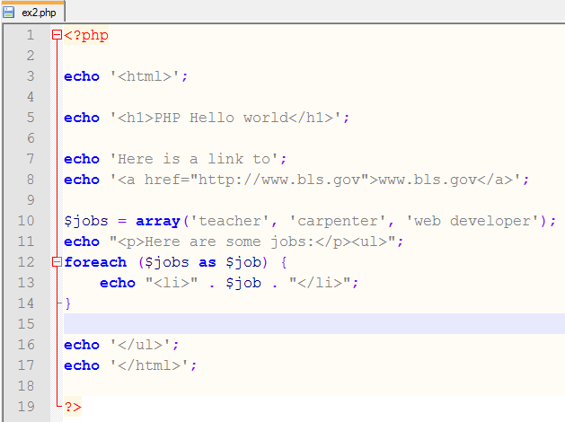
Try out PHP
Open ex2.php in Notepad++:

Slide 54
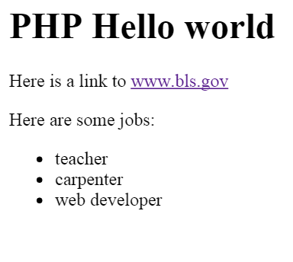
Try out PHP
localhost/webdb/ex2.php
Try:
Add a job to the array.
Reload the page in Firefox.
Try:
View Page Source in Firefox

Slide 55
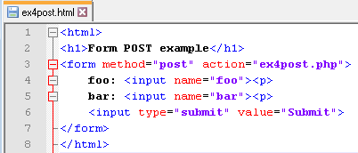
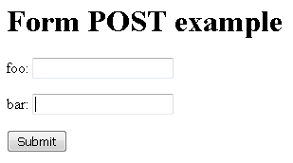
Sending Data to the Server
HTML Forms + HTTP POST
Provides a method for sending data from the client to the server
localhost/webdb/ex4post.html

Slide 56
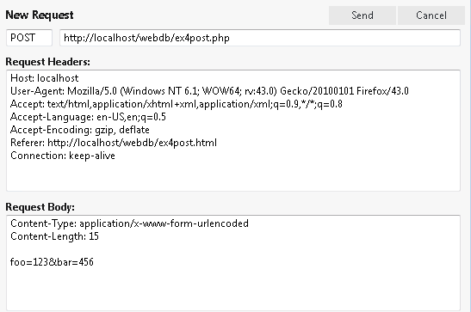
HTTP POST Request

Slide 57
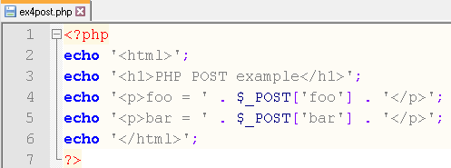
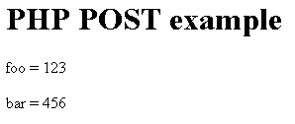
Server-Side Receives the POST

Slide 58
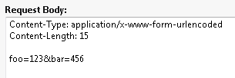
URL-Encoded Data

Slide 59
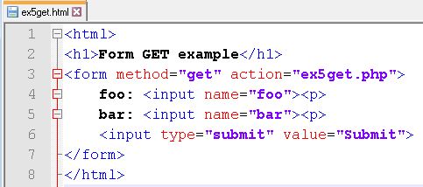
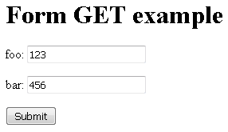
Sending Data using GET
HTML Forms + HTTP GET
Provides another method for sending data from the client to the server
localhost/webdb/ex5get.html

Slide 60
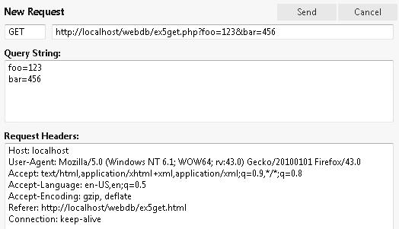
HTTP GET Request

Slide 61
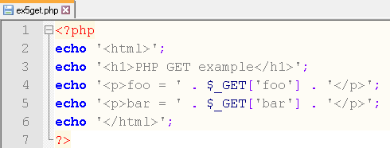

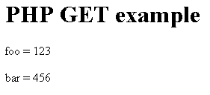
Server-Side Receives the GET

Slide 62
PHP $_GET and $_POST
PHP automagically fills these variables
with information sent from an HTML form
$ _GET[formvariablename]
$_POST[formvariablename]

Slide 63
PHP can also access databases
PHP can issue queries to databases that support SQL
Results are returned to PHP from the database
Then PHP can use these results to create HTML that is sent back to the client web browser

Slide 64
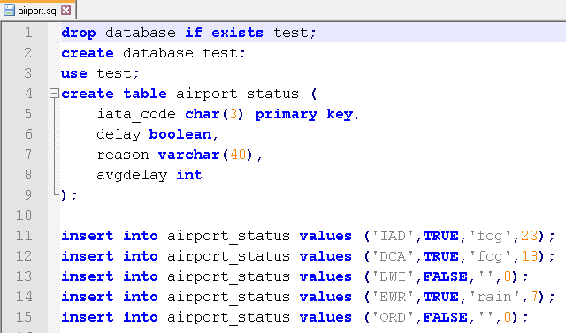
Example: Airport Status Database

Slide 65
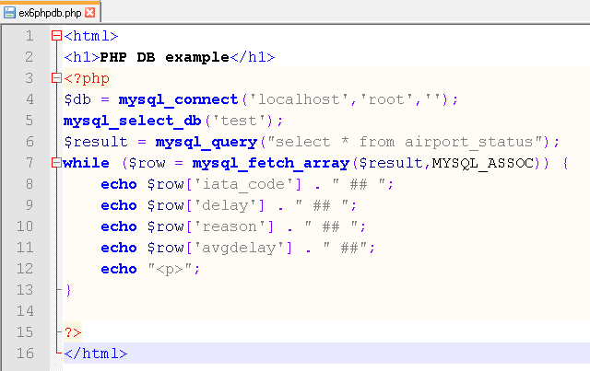
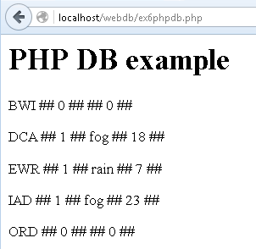
Accessing the DB from PHP

Slide 66
Part 3:
Security and User Input

Slide 67
User Input
Data sent by the client to the server presents challenges.
Users need to enter data into web sites
But... users could enter malicious data
Well designed web sites do NOT trust ANY user input or data sent by the client to the server.
Data received by the server is typically cleaned/sanitized depending its intended use.
Common uses:
Store in a database (e.g. name, address)
Display in HTML (back to the user, or to other users)
Compare against a stored value (e.g. logging in)

Slide 68
SQL Injection
SQL injection attacks attempt to execute SQL statements that include user input that becomes part of an SQL query
Consider:
$q = "select * from emp where eid = $_GET['eid']";
Cleaning/sanitizing data received by the server before using it in a query is one method to guard against these types of attacks. Other approaches include new ways to issue SQL queries from PHP.

Slide 69
Injection Example #1
create-test2.sql
drop database if exists test2;
create database test2;
use test2;
create table products (
pname varchar(40),
pdesc varchar(40),
price int
);
insert into products values ('gum','mint flavored',1);
insert into products values ('candy bar','chocolate',2);
insert into products values ('lollipop','red',1);
Reference: http://en.wikipedia.org/wiki/SQL_injection

Slide 70
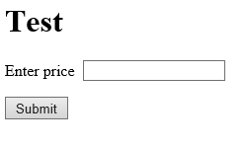
Injection Example #1
injection1.html
<html>
<h1>Test</h1>
<form method="get" action="injection1.php">
Enter data: &nbsp; <input type="text" name="fred">
<p>
<input type="submit" value="Submit">
</form>
Reference: http://en.wikipedia.org/wiki/SQL_injection

Slide 71
Injection Example #1
injection1.php
<html>
<h1>Injection Test 1</h1>
<?php
$db=mysql_connect('localhost','root','');
mysql_select_db('test2');
$q = 'select * from products where price=' . $_GET['fred'];
echo "SQL query = $q <p>";
$result = mysql_query($q);
while ($row = mysql_fetch_array($result,MYSQL_ASSOC)) {
echo $row['pname'] . " is \t$" . $row['price'] . "<p>";
}
?>
Reference: http://en.wikipedia.org/wiki/SQL_injection

Slide 72
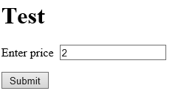
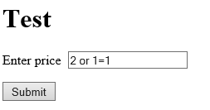
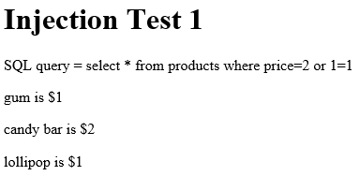
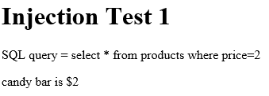
Injection Example #1
??
Reference: http://en.wikipedia.org/wiki/SQL_injection

Slide 73
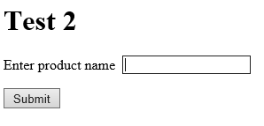
Injection Example #2
injection2.html
<html>
<h1>Test 2</h1>
<form method="get" action="injection2.php">
Enter product name&nbsp; <input type="text" name="fred">
<p>
<input type="submit" value="Submit">
</form>
Reference: http://en.wikipedia.org/wiki/SQL_injection

Slide 74
Injection Example #2
injection2.php
<html>
<h1>Inejction Test 2</h1>
<?php
$db=mysql_connect('localhost','root','');
mysql_select_db('test2');
$q = "select * from products where pname='" . $_GET['fred'] . "'";
echo "SQL query = $q<p>";
$result = mysql_query($q);
while ($row = mysql_fetch_array($result,MYSQL_ASSOC)) {
echo $row['pname'] . " is \t$" . $row['price'] . "<p>";
}
?>
Reference: http://en.wikipedia.org/wiki/SQL_injection

Slide 75
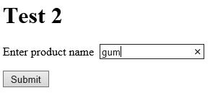
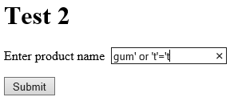
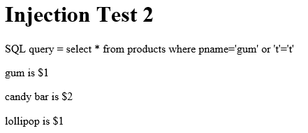
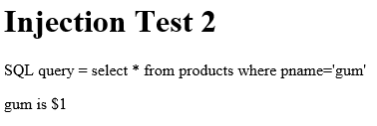
Injection Example #2
'gum' or 't'='t
??
Reference: http://en.wikipedia.org/wiki/SQL_injection

Slide 76
Security
What data should or should not be stored on a web server?
Possible harms
Exposure of confidential data
Loss of data
Considerations
Limit information, limit access
What services are running on the server?
Authentication mechanisms
Backups; RAID; offsite storage

Slide 77
Authentication
How do I know you are who you say you are?
Mechanisms
Usernames and passwords
Identity claim + verification (separate steps)
Biometrics
Secure IDs

Slide 78
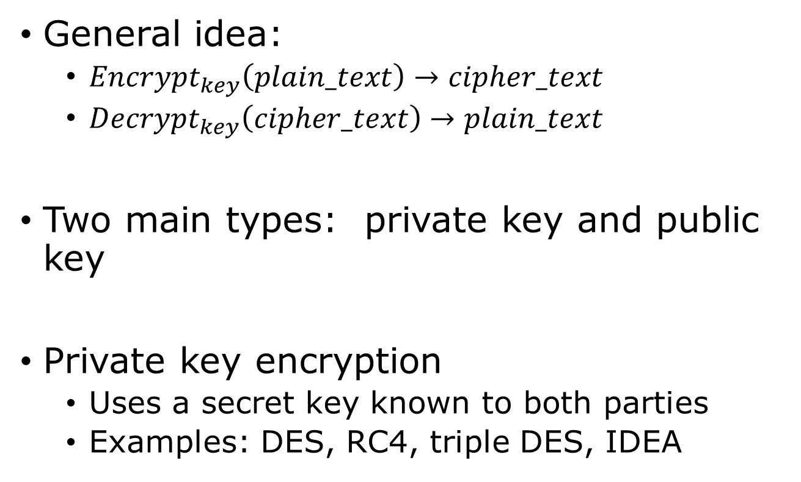
Encryption
General idea:
${Encrypt}_{key}\left(plain_text\right)→cipher_text$
${Decrypt}_{key}\left(cipher_text\right)→plain_text$
Two main types: private key and public key
Private key encryption
Uses a secret key known to both parties
Examples: DES, RC4, triple DES, IDEA

Slide 79
Public Key Encryption
Each person has two keys:
A public key that they tell to everyone
A private key that they don’t tell to anyone
A message encrypted with a person’s public key can only be decrypted with their private key
A message encrypted with a person’s private key can only be decrypted with their public key

Slide 80
Public Key Encryption
Question 1:
If Ann encrypts a message with Bob’s public key
Who can read it?
Do we know who encrypted the message?
Question 2:
If Bob encrypts a message with Ann’s public key?
Who can read it?
Do we know who encrypted the message?

Slide 81
Secure Sockets Layer (SSL)
Network protocol layers
Application layer HTTP | FTP | SMTP
Transport layer TCP | UDP
Network layer IP
SSL adds a “transparent” layer
Application layer HTTP
SSL layer SSL
Transport layer TCP | UDP
Network layer IP
SSL uses a combination of public key and asymmetric key encryption

Slide 82
Trusted Certificate Authorities
The problem:
How do you know that my public key is really mine and not someone else posing as me?
This is especially an issue for HTTPS (e.g., my bank’s web site)
Trusted Certificate Authorities
Issue certificates that identify an entity and their public key
Sign the certificates with the CA private key
How do we get/trust the CA public key?
Often, it comes installed with your computer OS or web browser
But… sometimes issues with that (e.g., 2015 Lenovo Superfish issue)

Slide 83
Part 4:
Session Control and User Authentication

Slide 84
Session Control
What is session control?
HTTP is stateless
So…
How do we keep track of users across multiple pages?
Answer:
Session control / management

Slide 85
Session control – How?
Session ID
Unique key to identify each session (e.g. 8c6ea32b1)
Web site example, visit sites, look at cookies/sids
Cookies
Small name-value pair of information stored at the client, placed by the server
Can be used to store a session id
Look at examples on websites such as Amazon.
Firefox → Hamburger → Options → Privacy
History → Use custom settings for history
Click “Show cookies”

Slide 86
Session Control using Cookies
Sess_ID | Data
123 | Username = joe Cart_items = { bluray player, starwars bluray, hdmi cable }
456 | Username = sally Cart_items = { xbox, hdmi cable, doritos }
... | ...
Web Server
On the server, PHP keeps a list of session ids and stores data associated with each session id.
Client Web Browser
Apache
PHP
First time client connects to server, client does not have a cookie with a session id.
Server (PHP) sends back a session id as a cookie in the HTTP response header.
The client then decides what to do with this cookie. In most cases, the client will save the cookie with the session id.
On later connections to the server, the client can choose to send the session id cookie back to the server (as part of the HTTP request header) so that the server will know that we are returning.
When the server sees the cookie with the session id, it can check to see if it has seen this session id before, and if so, it can then lookup and make use of the associated data it has stored (e.g., username, shopping cart).
If username is set, this might indicate that the user is logged in.

Slide 87
Sessions for User Accounts
Sessions are a convenient way to handle user accounts for a web site
Idea:
Store account information in MySQL
User logs in using a form
Verify username and password
Set session variables to indicate logged in

Slide 88
Part 5:
HTML5, Javascript and DOM

Slide 89
What is HTML5?
New version of HTML
CSS
Javascript
Ajax

Slide 90
What is Javascript?
Client-side scripting language
Runs inside your client Web browser
Supported by all major web browsers
Firefox, Chrome, Safari – all have implementations of Javascript
However some differences among browsers

Slide 91
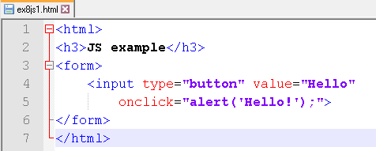

Simple Javascript Example
localhost/webdb/ex8js1.html

Slide 92
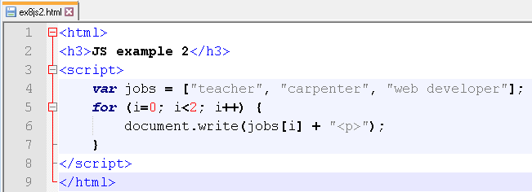
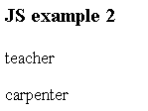
Javascript Example 2
localhost/webdb/ex8js2.html

Slide 93
Document Object Model (DOM)
Provides access
to the structure of a web document
on the client-side
programmatically (e.g., using Javascript)
No additional server access needed
Treat the web document as an object

Slide 94
DOM Example
HTML
<html>
<head>
<title>Restaurants</title>
</head>
<body>
<h1>List of restaurants</h1>
<h2>in the nearby area</h2>
<table border="1">
<tr>
<td>McDonalds</td>
<td>123 Main St.</td>
</tr>
<tr>
<td>The Capital Grille</td>
<td>456 Main St.</td>
</tr>
</table>
<body>
</html>
HEAD
BODY
TITLE
H1
H2
TABLE
#text:
List of restaurants
#text:
in the nearby area
#text:
Restaurants
TBODY
TR
TR
TD
TD
TD
TD

Slide 95
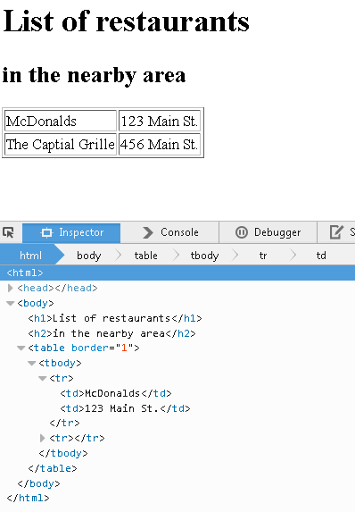
DOM Inspection
Firefox
Web Developer → Inspector

Slide 96
Part 6:
Ajax and jQuery

Slide 97
What does AJAX do?
Traditional use of HTTP causes pages to be reloaded when data is exchanged
AJAX uses JavaScript to exchange data with the server without reloading the current page.
Web applications can look/act more like desktop apps

Slide 98
AJAX vs. Traditional
Traditional HTTP communication
User clicks a link or presses a form button
Client browser makes an HTTP request using either GET or POST
Server processes request and sends a response
Browser loads the response in a new web page

Slide 99
AJAX vs. Traditional
AJAX
JavaScript event fires
Client browser makes asynchronous HTTP request using JavaScript
Client sets a handler to process the response when it arrives
When the response arrives, the client handler does something
For example, update just a PART of the page

Slide 100
jQuery
jQuery is a popular Javascript library
Includes good support for Ajax
One option is to use a Google-hosted version
Nothing to download
To use, include:
<script
src="http://ajax.googleapis.com/ajax/libs/jquery/1.11.2/jquery.min.js">
</script>

Slide 101
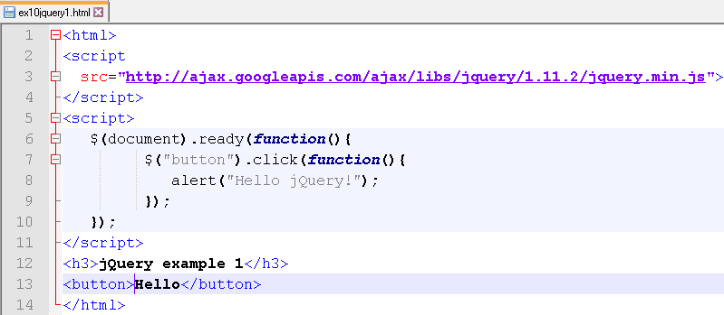

Try out jQuery
localhost\webdb\ex10jquery1.html
Try:
Replace click with mouseenter
...with mouseleave

Slide 102
jQuery
A common pattern for using jQuery is to:
SELECT some (HTML) elements from the page
Perform some action on the selected elements
Syntax:
$(selector).somemethod()
Examples:
$("p").hide() // hides all <p> elements
$("#fred").hide() // hides element with id="fred"
The selectors use CSS selector syntax

Slide 103
jQuery Events
Good references:
https://api.jquery.com/category/events/
Events
.focus() .blur()
.click()
.mouseenter() .mouseleave()
.keydown() .keyup()

Slide 104
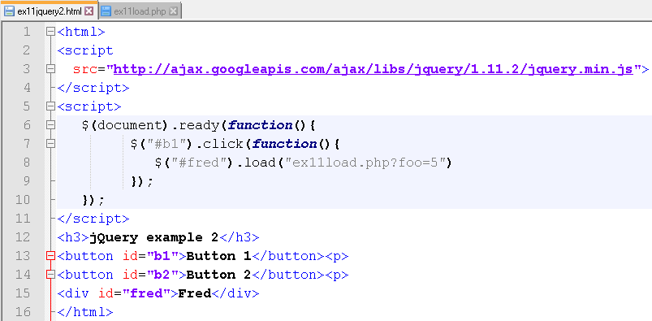
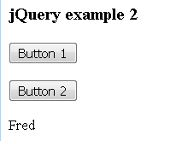
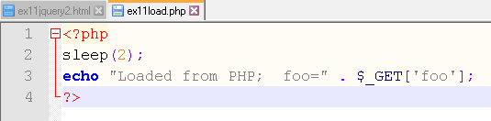
jQuery AJAX .load()
localhost\webdb\ex11jquery2.html
localhost\webdb\ex11load.php

Slide 105
HTML5 / Javascript implications for preservation
HTML5, Javascript, AJAX support “web application” style dynamic content
Can be highly interactive
May rely on other data sources
Opportunities for data access
Challenges/implications for archiving

Slide 106
Part 7:
JSON

Slide 107
JavaScript Object Notation (JSON)
Text representation of a JavaScript data object
Common data format for data exchange
Supported by many languages
Lots of data is available in JSON format
Data.gov

Slide 108

JSON Data
http://services.faa.gov/docs/services/airport/

Slide 109
JSON Example
http://services.faa.gov/airport/status/iad?format=application/json
{
"delay":"false",
"IATA":"IAD",
"state":"District of Columbia",
"name":"Washington Dulles International",
"weather":
{
"visibility":0.25,
"weather":"Light Drizzle Fog/Mist",
"meta":
{
"credit":"NOAA's National Weather Service",
"updated":"12:52 PM Local",
"url":"http://weather.gov/"
},
"temp":"41.0 F (5.0 C)",
"wind":"North at 0.0mph"
},
"ICAO":"Kiad",
"city":"Washington",
"status":
{
"reason":"No known delays for this airport.",
"closureBegin":"",
"endTime":"",
"minDelay":"",
"avgDelay":"",
"maxDelay":"",
"closureEnd":"",
"trend":"",
"type":""
}
}
{ indicates a new array
} indicates end of array
"key":"value" are key-value pairs
value can be another array
Examples:
$obj['delay'] value is "false"
$obj['IATA'] value is "IAD"
$obj['weather'] value is an array
$obj['weather']['visibility'] value is 0.25
$obj['weather']['meta']['url'] value is "http://weather.gov/"
$obj['city'] value is "Washington"

Slide 110

JSON Example
C:\xampp\webdb\ex7json.php

Slide 111

In Firefox, go to URL:
Localhost/webdb/ex7json.php

Slide 112
usa.gov bit.ly data
Every time someone created a shortened URL using bit.ly of a US gov website (.gov, .mil), a record is logged:
{'a': u'Mozilla/5.0 (Windows NT 6.1; WOW64) AppleWebKit/535.11 (KHTML, like Gecko) Chrome/17.0.963.78 Safari/535.11',
'c': 'US', 'nk': 1, 'tz': 'America/New_York', 'gr': 'MA', 'g': u'A6qOVH', 'h': u'wfLQtf', 'cy': 'Danvers', 'l': 'orofrog',
'al': 'en-US,en;q=0.8', 'hh': '1.usa.gov',
'r': 'http://www.facebook.com/l/7AQEFzjSi/1.usa.gov/wfLQtf',
'u': 'http://www.ncbi.nlm.nih.gov/pubmed/22415991', 't': 1331923247, 'hc': 1331822918,
'll': [42.576698, -70.954903]}

Slide 113


https://github.com/usagov/1.USA.gov-Data

Slide 114
Part 8:
XML

Slide 115
HTML
HTML
<html>
<head>
<title>Restaurants</title>
</head>
<body>
<h1>List of restaurants</h1>
<h2>in the nearby area</h2>
<table border="1">
<tr>
<td>McDonalds</td>
<td>123 Main St.</td>
</tr>
<tr>
<td>The Capital Grille</td>
<td>456 Main St.</td>
</tr>
</table>
<body>
</html>
HEAD
BODY
TITLE
H1
H2
TABLE
#text:
List of restaurants
#text:
in the nearby area
#text:
Restaurants
TBODY
Hierarchical structure
Common understanding of tags
TR
TR
TD
TD
TD
TD

Slide 116
EXtensible Markup Language (XML)
<?xml version="1.0" encoding="ISO-8859-1"?>
<release>
<title>Punch the Clock</title>
<artist>Elvis Costello and
The Attractions</artist>
<date><day>5</day>
<month>August</month>
<year>1983</year>
</date>
<label>F-Beat/Columbia</label>
</release>
Data description language
Hierarchical structure
Tags and meanings are NOT pre-defined
References and resources:
http://www.w3schools.com/xml/xml_whatis.asp
http://www.w3schools.com/xml/xml_syntax.asp

Slide 117
XML-based languages
SVG
RDF
RSS
VoiceXML

Slide 118
XPath Tree
<?xml version="1.0" encoding="ISO-8859-1"?>
<?xml-stylesheet type="text/xsl" href="music1.xsl"?>
<collection>
<release country="USA">
<title>Look Sharp!</title>
<artist>Joe Jackson</artist>
<date><month>April</month><year>1979</year></date>
<label>A&amp;M</label>
</release>
<release>
<title>Night and Day</title>
<artist>Joe Jackson</artist>
<date><year>1982</year></date>
</release>
</collection>
Root node
<collection>..</collection>
<?xml-stylesheet…?>
<release>..</release>
<release>..</release>
<title>..</title>
<artist>..</artist>
<date>..</date>
<label>..</label>
<title>..</title>
<artist>..</artist>
<date>..</date>
<month>..</month>
<year>..</year>
<year>..</year>

Slide 119
XSL Transformations (XSLT)
Very powerful
XSLT provides a way to
transform one XML document into another
or into some other format (such as HTML)
Allows manipulation of XML elements
Uses XPath

Slide 120
Part 9:
REST APIs

Slide 121
REST(ful) APIs
Remember HTTP?
Client-server requests and responses
Requests and responses have header and body components
GET resource_name
POST resource_name
HEAD resource_name
We saw how HTTP was used to request Web pages and to send data to the server.
HTTP also includes:
PUT resource_name
DELETE resource_name

Slide 122
REST(ful) APIs
REST
Is a way of designing/implementing interfaces to Web services
HTTP Verbs (GET, PUT, DELETE, POST)
Resources (things/nouns) are indicated by URLs
HTTP Verbs are used to indicate actions to be taken on resources

Slide 123
REST(ful) APIs
Imagine an online service with airport information
REST Examples
GET /airports
A request to get a list of airports from the service
Could return HTML, text, JSON, XML or other formats
Format desired could be specified by the HTTP request header
GET /airports/iad
A request to get detail information about a specific airport (IAD)
PUT /airports/ewr
A request to create or update information about a specific airport (EWR)
Information to update could be sent in the request body in JSON, XML, etc.
Server response status code could indicate success/failure/issue
DELETE /airports/ord
A request to delete a specific airport from the service (ORD)
Server response status code could indicate success/failure/issue

Slide 124
REST(ful) APIs
Advantages/Notes
Query, create, update, delete, modify are common operations
These map easily to HTTP verbs: GET, PUT/POST, DELETE
Data objects can be specified as HTTP resources
REST provides a common framework for understanding a Web service API
Other approaches (e.g. SOAP) may be more specific to each Web service
Many Web services provide REST APIs
State is maintained on server
Example: Twitter API
https://dev.twitter.com/rest/public
https://dev.twitter.com/rest/reference/get/statuses/user_timeline

Slide 125
REST API Example
Handout

Slide 126
Feeds
Atom
RSS

